Slide 1




Research Design

Slide 2
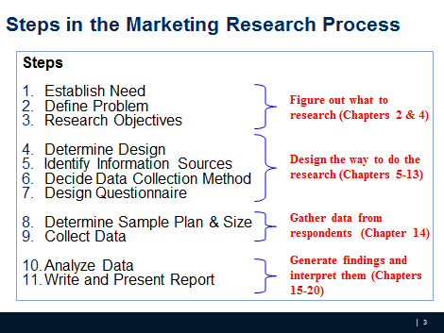
Where we are

Slide 3
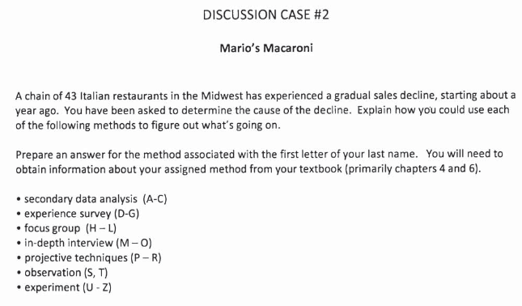
Discussion Case #2
iCliker - write your answer in 2-3 sentences on iClicker
Notes:
What could be the potential causes that a restaurant is having a gradual sales decline? Pick a specific method and consider the probable cause

Slide 4
Research Design
Research design is a set of advance decisions that make up the master plan specifying methods and procedures for collecting and analyzing the needed information

Slide 5
Types of Research Design
The choice of the most appropriate design depends largely on the objectives of the research and how much is known about the problem

Slide 6
Types of Research Design
Three traditional categories/methods:
Exploratory
Descriptive
Causal
Notes:
When we did text mining in the first session, what would you call it?

Slide 7
Exploratory Research
Exploratory research is most commonly unstructured, informal research that is undertaken to gain background information about the general nature of the research problem
By unstructured, we mean there is no formal set of objectives, sample plan, or questionnaire.

Slide 8
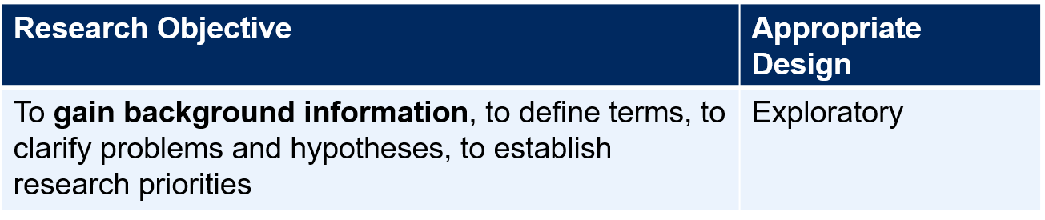
Exploratory Research (Qualitative Research)
  Many questions; many sources
  Defining the problem; getting a “feel”
Goal: generate ideas (e.g., what, why) for descriptive and exploratory research ( quantitative research). See example.
Uses:
Gain Background information
  What is a bank image study?
Define Terms
  What terms are used?
Clarify problems and hypothesis
  What type of bank customers? Retail? Commercial? Correspondent banks?
Establish Research Priories
Notes:
RQ: What criteria do household use when selection department store. Why do they do so?
See the talking points with client

Slide 9
Research Design: Exploratory Research
A variety of methods are available to conduct exploratory research
    Ethnography: Living the experience, observation without interference
    Case Analysis
    Focus Groups: Talk to people to get their opinion
    Secondary data analysis
    Others (Depth Interview, protocol analysis, projective techniques)

Slide 10
Focus Groups
Focus groups are small groups of people brought together and guided by a moderator through an unstructured, spontaneous discussion for the purpose of gaining information relevant to the research problem

Slide 11
Types of Focus Groups
Traditional: Select 6 to 12 people and meet in a dedicated room with one-way mirror for client viewing, for about two hours
Nontraditional: Online with 25-50 respondents, allow clients participate

Slide 12
Pros and Cons of Focus Groups
Pros:
Generate fresh ideas
Allow clients to observe their participants
May be directed at understanding a wide variety of issues
Allow fairly easy access to special respondent groups
Cons:
Representativeness of participants
Interpretation sometimes difficult
High Cost per participant
Cannot be used for prediction

Slide 13
Interview guide (for meeting with the client)
1. What is the product/service being provided?
2. What is special 'unique about the product/service?
3. Does the client know who their competition is?
4. Is there a special group of people (such as college students) that the product/service is meant for? Are there different groups of people that the client thinks uses their product/service?
5. Does the client think the different groups think of their product/service differently?
6. What information does the client hope to get from this project? Do they want this information?
7. What are the different things that the client wants to know? Prioritize these questions.
8. What decisions will the client make using the information above? There should be several alternatives that you should get from the client for this decision- e.g., where to advertise their product is the decision that will be aided by your project. The decision alternatives would be advertised in Add Sheet, Columbia Tribune, Missourian, Radio, Television etc.
Notes:
(Point 1- 3 for identifying the problem and causes, point 4-5: target customers and difference type RQ, point 6-7: info needs to form your research objections and their prioritization, point 8: decision alternatives).

Slide 14
Descriptive Research
Descriptive research is undertaken to describe answers to questions of who, what, where, when, and how.
Descriptive research is desirable when we wish to project a study’s findings to a larger population, if the study’s sample is representative

Slide 15
Descriptive Research
Goal: quantify the responses (e.g., how much?What percent?)
Example: questionnaire/ survey
Uses
  Measure performance
    How is the bank doing in terms of customer satisfaction?
  Assess market related phenomena
    Why people prefer brand X over Y
Research Objective | Appropriate Design
To describe and measure marketing phenomena at a point in time | Descriptive

Slide 16
Vague research question for survey research
CE1

Slide 17
Research Design: Descriptive Research
Cross-sectional: measure units from a sample of the population at only one point in time. E.g., Survey
Longitudinal: repeatedly measure the sample over time. E.g., Panels (continuous vs. discontinuous)
Notes:
Two basic classifications:
Cross-sectional: measure units from a sample of the population at only one point in time. E.g., Survey
Longitudinal: repeatedly measure the sample over time. E.g., Panels (continuous vs. discontinuous)

Slide 18
Marketing Research Panels
Continuous panels ask panel members the same questions on each panel measurement. Uses – Brand tracking studies, measure change in consumer attitude, behavior etc.
Discontinuous panels (also known as Omnibus) vary questions from one panel measurement to the next. Uses – provide a very broad sample

Slide 19
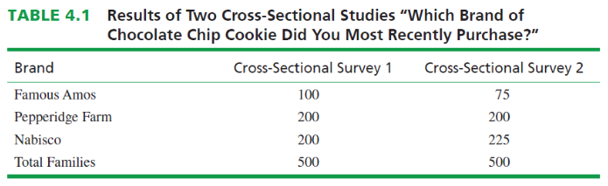
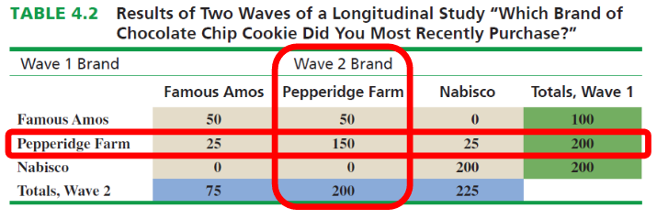
Marketing Research Panels - does Pepperidge Farm need to worry about its competitors?

Slide 20

Causal Research
Causality may be thought of as understanding a phenomenon in terms of conditional statements of the form “If x, then y.”
Causal studies are conducted through the use of experiments

Slide 21
Causal Research
Uses
  To find causes
    What makes movies like “The Dark Knight Rises” appeal to masses
    Does background music affects purchase behavior
Research Objective | Appropriate Design
To determine causality, to make “if- then” statements | Causal

Slide 22
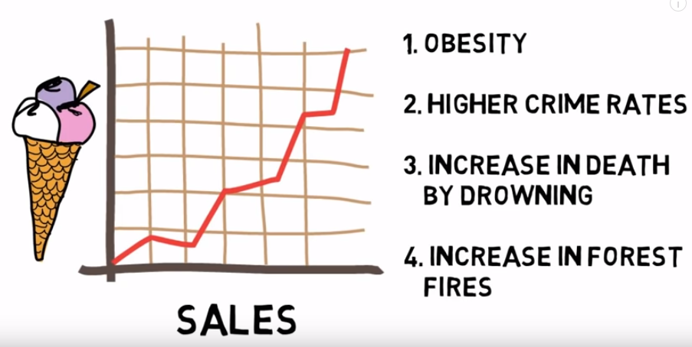
Causality – or is it really?

Slide 23
Research Design: Causal Research
An experiment is defined as manipulating an independent variable to see how it affects a dependent variable, while also controlling the effects of additional extraneous variables.
Two Types of Experiments
Laboratory Experiment
Field Experiment

Slide 24

Example of Causal Research: Test Marketing
Test marketing is the phrase commonly used to indicate an experiment, study, or test that is conducted in a field setting.
Uses of test markets:
    To test sales potential for a new product or service
    To test variations in the marketing mix for a product or service

Slide 25
Independent Variable
Independent variables are those variables which the researcher has control over and wishes to manipulate. (E.g., level of ad expenditure; type of ad appeal; price; product features, etc.)

Slide 26
Dependent Variable
Dependent variables are those variables that we have little or no direct control over, yet we have a strong interest in. E.g., return on investment (ROI), net profits, market share, customer satisfaction.

Slide 27
Extraneous Variables
Extraneous variables (control variables) are those
variables that may have some effect on a dependent
variable yet are not independent variables.
Extraneous variables must be controlled through proper experimental design.

Slide 28
Experimental Design
Experimental design is a procedure for devising an experimental setting such that a change in a dependent variable may be attributed solely to the change in an independent variable.
iClicker: how would you design an experiment to assess if the ‘buy one get one free’ on shoes promotion increases the sale during Christmas?

Slide 29
Experimental Design
Experimental group (R) O1 X O2
Where Effect: (O2 - O1)

Slide 30
Experimental Design
Experimental group (R) O1 X O2
Control group (R) O3 O4
Where E: (O2 - O1) - (O4-O3)

Slide 31
Pretest and Posttest
Pretest refers to the measurement of the dependent variable taken prior to changing the independent variable (IV)
Posttest refers to the measurement of the dependent variable after changing the independent variable (IV)

Slide 32
Validity
Internal Validity: the extent to which the researcher is certain that a change in a dependent variable is actually due to the independent variable
External validity is taken care of if the test and control groups are representative

Slide 33
Recap – iClicker poll
Research Design:
Master plan of how to go about collecting and analyzing information
Types of Research Design:
Exploratory
Descriptive
Causal
Examples??
Notes:
There are basic marketing research designs that can be successfully matched to given problems and research objectives, and they serve the researcher much like the blueprint serves the builder.

Slide 34
What’s coming?
Answer to vague RQ in CE1
Discussion case #3
PA3

Slide 35
5-min Snippet

